Slide 1
I Didn’t See That Coming
There are close to 20,000 known burials at the Nashville City Cemetery
340 of those individuals met a most unexpected death
Notes:
Accounts for less than 2% of the burials, but arguably the most interesting

Slide 2
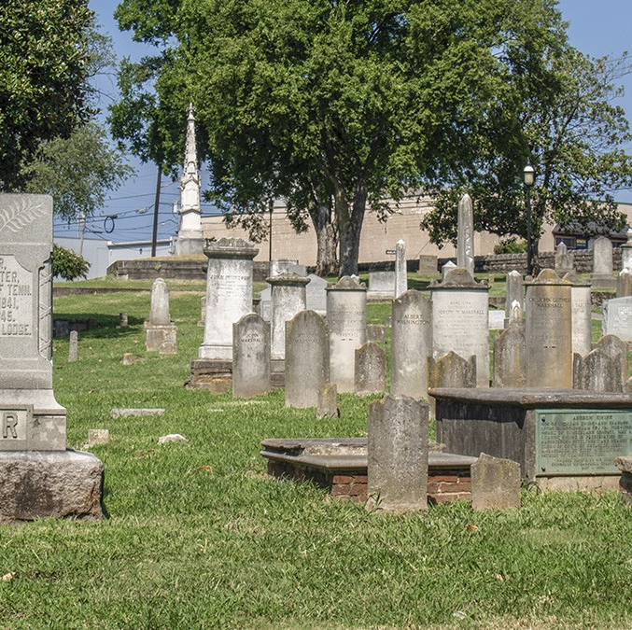
Causes of Death
Some of these deaths were very specific:
“Kicked by a horse”
“Fell through the hatch on a boat”
“Killed by explosion of powder in cap factory”
Others, more general:
“Poison”
“Drowning”
“Burn”

Slide 3
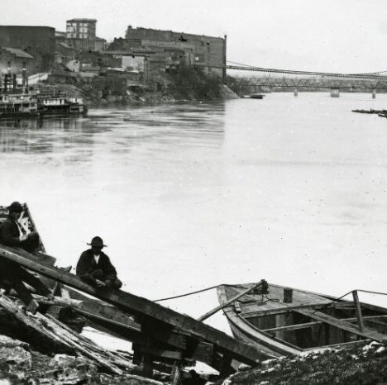
I’ll Take Two
There are two people here at the Nashville City Cemetery that were the unfortunate victims of a horrible accident
Wm.R. Tadlock & Charles Bradbery
On June 16, 1855 a portion of the old suspension bridge (present day Woodland Street Bridge) collapsed, resulting in their falling into the river and drowning

